Slide 1


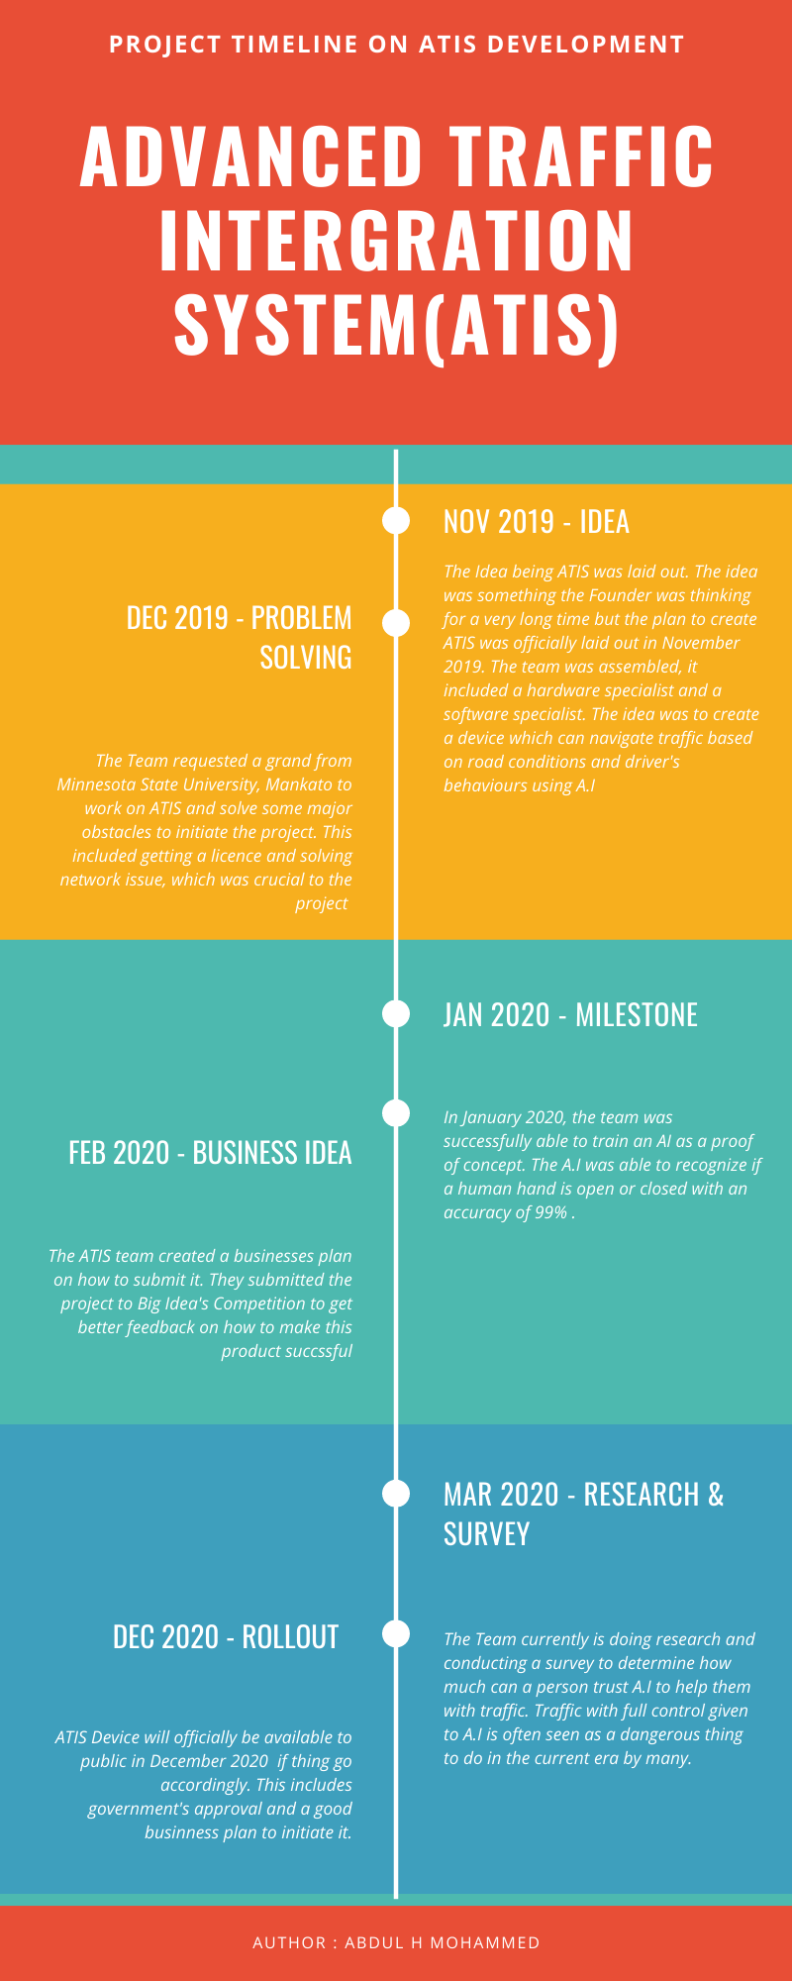


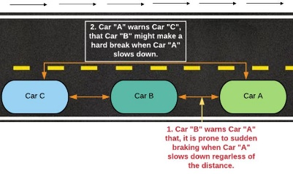
Advanced Traffic Integration System
Product Research & Survey
Abdul H Mohammed
ENG-271W Technical Communication
Abstract
Research Timeline
Conclusion
We currently live in an era where science and technology run the world. Most of the common things around us are getting advanced, intelligent and smart. This doesn’t necessarily mean everything. One of the things that are getting better every day is transportation. Driving experience today has completely changed when compared to driving back in the 60s or 70s. Vehicles are now safer, advanced, intelligent and becoming eco-friendlier as we progress. Autonomous vehicles are getting more common as we move forward. One thing that has not changed since its introduction is the way traffic operates, roads and highways. As vehicles that drive on it get smarter, we find it necessary to make the functions of the traffic and roads advanced and intelligent. Hence, the proposal of ATIS (Advanced Traffic Integration System). One of the core ideas behind ATIS to create a smarter and safer way to deal with day to day traffic operations, the way cars drive on the roads, etc. It is a device that can connect the vehicles with its surrounding environment, including road signs, traffic lights, law enforcement, etcetera without using expensive and bulky hardware.
With the boom of technology, IoTs and the world getting closer to making a complete smart city, ATIS is a necessary addition. With the good possibly of driverless cars to be common on the road within a decade or two, The ATIS device should a mandatory addon on every vehicle on the road. ATIS is customizable to the point that its features can be added as it advances giving the developers limitless options and opportunity to take advantage of using machine learning and Artificial Intelligence.
Based on the survey I can also confidently say that, if this device is rolled out in the market, it could be a hit among the millennials. The survey also proved that over 93 percent of the people agree that the roads and highways need a significant safety upgrade. I strongly believe ATIS is an answer to this!
Survey
After understanding the test results, one of the most important things was to find out people’s opinion, research habits and impact. I created a survey online on Google forms asking people wide variety of questions based on their driving history, age and opinion on smart driving. The results of the survey were very interesting, gave us a better understanding on where people stand and how its going to affect the device sales are going to be affected when it finally releases. The survey gave me some insights on two different topics. One of the things I was targeting was to find out opinions based on age and history specifically. In the survey, I asked questions if they were any major or minor car accidents, another question I asked was how much they would trust their car safety system and how much would they trust a fully autonomous car. The answers were the complete opposite than I expected. I expected people who were involved in an accident would be less confident to sit in a self-driving car but surprisingly it was the opposite.
References
Introduction
1.Tesla Autopilot. (2019, October 27). Retrieved October 30, 2019, from https://en.wikipedia.org/wiki/Tesla_Autopilot.
2. (2019, June 18). Vehicle-to-Vehicle Communication. Retrieved October 30, 2019, from https://www.nhtsa.gov/technology-innovation/vehicle-vehicle-communication.
3. RF Wireless World. (n.d.). Retrieved October 30, 2019, from https://www.rfwireless-world.com/Terminology/Advantages-and-Disadvantages-of-V2X-Communication.html.
4. Abuelsamid, S. (2018, April 16). Toyota Has Big Plans To Get Cars Talking To Each Other And Infrastructure In The U.S. Retrieved October 30, 2019, from https://www.forbes.com/sites/samabuelsamid/2018/04/16/toyota-launches-aggressive-v2x-communications-roll-out-from-2021/#73abc0ae146c.
5. Woo, J. W., Yu, S. B., & Lee, S. B. (2016, April 9). Design and simulation of a vehicle test bed based on intelligent transport systems. Retrieved November 15, 2019, from https://link.springer.com/article/10.1007/s12239-016-0036-7.
6. Keeping the vehicle on the road: A survey on on-road lane detection systems. (n.d.). Retrieved November 15, 2019, from https://dl.acm.org/citation.cfm?id=2522970
7. Nvidia Jetson Nano from https://developer.nvidia.com/embedded/jetson-tx1-developer-kit.
One of the main concepts behind the idea is to invent a device (ATIS), that can be equipped to vehicles, traffic signals, road signs etc. We currently have the technology where a vehicle can detect surrounding vehicles speed, collisions, pedestrians and other stuff using the conventional radar system and object recognition cameras. This is just one-way communication. Although some vehicle manufacturers like Tesla have bit advanced feature where there might be a limited intelligent communication between vehicles if there are from the same manufacturers. I plan to achieve a fully establish two-way intelligent communication between vehicles regardless of them being from different manufacturers using ATIS. ATIS will also be open source to some extend allowing vehicle manufacturers to customize and comply the device according to their requirements and business models.
Graph - (X-Axis represents the age and the Y-Axis represents the trust rating (0-5))
What does it do?
As expected, the trust level of riding in an autonomous car is low are the age category expected but what I did not expect was that people did not loose confidence or trust while riding a self-driving car even though they where involved in a major car accident. I personally reached out to some of those people and many gave a common explanation. They said that the accident they where involved could have been avoided if not for human error. Hence, they trust computer more than humans itself. This was a very interesting observation.
Another observation I made, that was very crucial and directly related to ATIS was comparing the answers to the two questions in the survey. The questions were “How much do you trust your car's safety features like reverse camera, automatic braking systems, front radar, Blind spot warning, etc...” and “Opinion: Roads and Highways need a significant safety upgrade”.
ATIS Functionality
In general, ATIS processes necessary data like when a car is about to make a complete stop, drastic speed change, turn, incoming pedestrian, just like V2V but on the advanced side of ATIS, using machine learning it records, collects and analyzes driver’s driving habits, frequent mistakes, reactions and way of driving in different road and weather conditions, reactions & habits on long drives, congested roads, etc. After analyzing the data, it sends out data to other drivers in the surrounding on a need to know basis or just as a cautious and alert warning and in many cases to the traffic signals and road signs.
An Example of ATIS Features
An example of how ATIS works and is beneficial in the following case: The driver of Car B as shown figure 1 is a beginner driver and is prone to sudden braking or hard braking when he sees a car in front of him slowing down(Car A), regardless of the distance between the two cars. Car B’s sudden stop on a highspeed highway might be lethal to Car B and the car behind it, which is Car C, both cars most likely might collide. Given that all cars in our situation are equipped with ATIS devices, ATIS device installed in Car B is familiar with the Driver’s habits, it sends an alert to Car A’s ATIS about this particular habit in case Car A might slow down. When car A slows down or is about to slow down, Car A sends out an alert to the ATIS device of Car C to slow down and be cautious in case Car B might make use of hard breaks. Hence preventing a collision.
Thank You!
While this is a one-sided opinion, the side that disagreed that “Roads and Highways need a significant safety upgrade” also gave a 5/5 rating on their car safety system. My understanding is that those individuals believe that car safety is not related to road safety or that as long as the car is safe the road safety doesn’t play a major role.
The responses of this survey were very fruitful. I know have a better understanding on how people feel about smart roads and cars. This will also help me significantly to see where can I advertise this device if I am using targeted advertising
Figure -: Example of ATIS features

